Slide 1
Informatica PowerCenter
Lesson 13: Dynamic Lookup

Slide 2
Lesson Objectives
In this Lesson you will learn about:
  Static Cache
  Dynamic Cache

Slide 3
13.1: Static Cache
Uncached Lookup Or Static Cache
By default, the Integration Service creates a static lookup cache when you configure a Lookup transformation for caching.
The Integration Service builds the cache when it processes the first lookup request.
It queries the cache based on the lookup condition for each row that passes into the transformation.
The Integration Service processes an uncached lookup the same way it processes a cached lookup except that it queries the lookup source instead of building and querying the cache.

Slide 4
13.1: Static Cache
Uncached Lookup Or Static Cache
When the lookup condition is TRUE
  The Integration Service returns the values from the lookup source or cache
  For connected Lookup transformations, the Integration Service returns the values represented by the lookup/output ports
  For unconnected Lookup transformations, the Integration Service returns the value represented by the return port
When the look up condition is NOT TRUE
  The Integration Service returns either NULL or default values
  For connected Lookup transformations, the Integration Service returns the default value of the output port when the condition is not met
  For unconnected Lookup transformations, the Integration Service returns NULL when the condition is not met

Slide 5
13.2: Dynamic Cache
Dynamic Lookup Cache
For relational lookups, you might want to configure the transformation to use a dynamic cache when the target table is also the lookup table.
When you use a dynamic cache, the Integration Service updates the lookup cache as it passes rows to the target.
The Integration Service builds the cache when it processes the first lookup request.
It queries the cache based on the lookup condition for each row that passes into the transformation.

Slide 6
13.2: Dynamic Cache
Dynamic Lookup Cache
When the Integration Service reads a row from the source, it updates the lookup cache by performing one of the following actions:
  Inserts the row into the cache
  Updates the row in the cache
  Makes no change to the cache
The Integration Service either inserts or updates the cache or makes no change to the cache, based on the results of the lookup query, the row type, and the Lookup transformation properties you define.
Notes:
When the Integration Service reads a row from the source, it updates the lookup cache by performing one of the following actions:
Inserts the row into the cache. The row is not in the cache and you specified to insert rows into the cache. You can configure the transformation to insert rows into the cache based on input ports or generated sequence IDs. The Integration Service flags the row as insert
Updates the row in the cache. The row exists in the cache and you specified to update rows in the cache. The Integration Service flags the row as update. The Integration Service updates the row in the cache based on the input ports.
Makes no change to the cache. The row exists in the cache and you specified to insert new rows only. Or, the row is not in the cache and you specified to update existing rows only. Or, the row is in the cache, but based on the lookup condition, nothing changes. The Integration Service flags the row as unchanged.

Slide 7
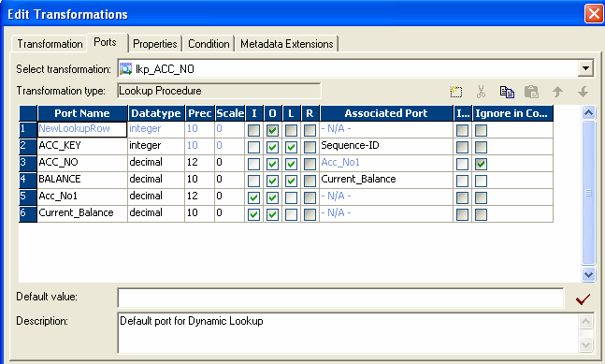
13.2: Dynamic Cache
Dynamic Lookup Cache
A Lookup transformation using a dynamic cache has the following properties:
NewLookupPort
Associated Sequence ID
Ignore in Comparison
Associated Port
Figure 13.1
Notes:
NewLookupRow. The Designer adds this port to a Lookup transformation configured to use a dynamic cache. Indicates with a numeric value whether the Integration Service inserts or updates the row in the cache, or makes no change to the cache. To keep the lookup cache and the target table synchronized, you pass rows to the target when the NewLookupRow value is equal to 1 or 2.
Associated Port. Associate lookup ports with either an input/output port or a sequence ID. The Integration Service uses the data in the associated ports to insert or update rows in the lookup cache. If you associate a sequence ID, the Integration Service generates a primary key for inserted rows in the lookup cache.
Ignore Null Inputs for Updates. The Designer activates this port property for lookup/output ports when you configure the Lookup transformation to use a dynamic cache. Select this property when you do not want the Integration Service to update the column in the cache when the data in this column contains a null value.
Ignore in Comparison. The Designer activates this port property for lookup/output ports not used in the lookup condition when you configure the Lookup transformation to use a dynamic cache. The Integration Service compares the values in all lookup ports with the values in their associated input ports by default. Select this property if you want the Integration Service to ignore the port when it compares values before updating a row.

Slide 8
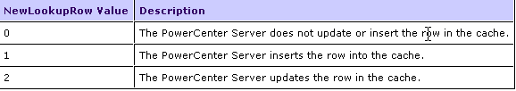
13.2: Dynamic Cache
Using New Lookup Row Port
When you define a Lookup transformation to use a dynamic cache, the Designer adds the New Lookup Row port to the transformation
The Integration Service assigns a value to the port, depending on the action it performs to the lookup cache
New Look UP Row values
Notes:
When the Integration Service reads a row, it changes the lookup cache depending on the results of the lookup query and the Lookup transformation properties you define. It assigns the value 0, 1, or 2 to the NewLookupRow port to indicate if it inserts or updates the row in the cache, or makes no change.

Slide 9
Summary
This lesson has taught basically two parts:
  Static Cache
  Dynamic Cache

Slide 10
Review Question
Question 1: If a Lookup transformation is configured to use a dynamic cache, the Designer adds the __________ port to the transformation.
Question 2: The Integration Service uses the data in the _______ports to insert or update rows in the lookup cache.

